Slide 1
RTOS
Semaphores

Slide 2
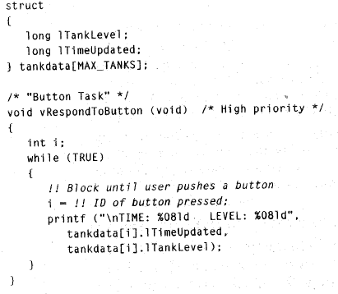
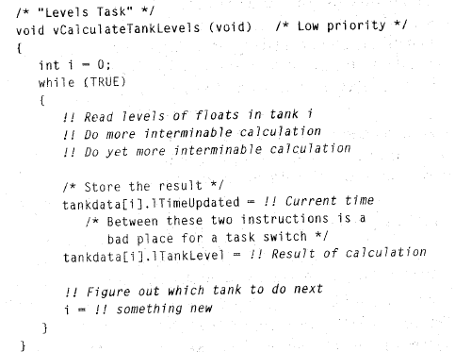
Shared Data Problem
EXAMPLE - 1

Slide 3
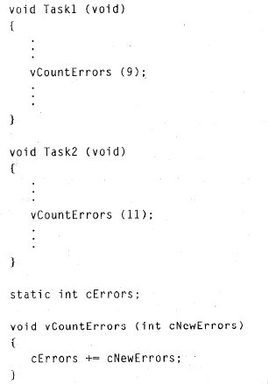
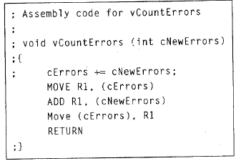
EXAMPLE - 2

Slide 4
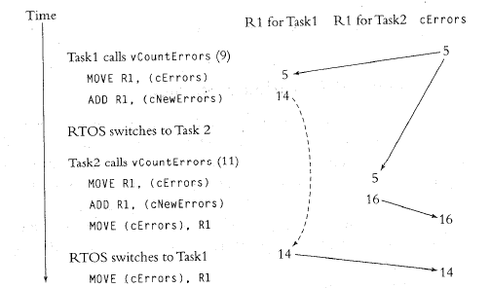
Example – 2 contd.
Let us say initial value of cErrors=5
Our required value:
5 + 9 + 11 = 25
But answer is 14
Notes:
Kernel provides us tools like semaphores to deal with such situation

Slide 5
Semaphore
A semaphore (sometimes called a semaphore token) is a kernel object that one or more threads of execution can acquire or release for the purpose of synchronization or mutual exclusion.

Slide 6
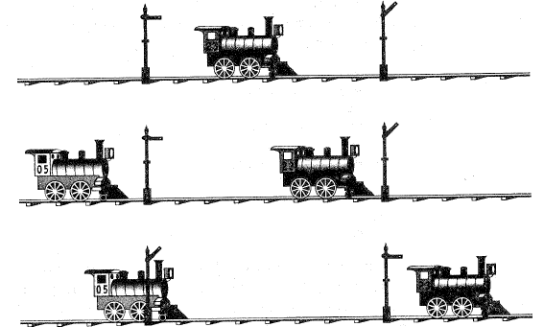
History of Semaphore
Notes:
In order to avoid a situation in which one train runs into another train, semaphores signals were invented.

Slide 7
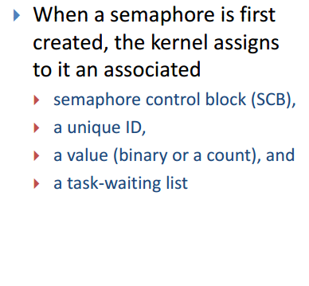
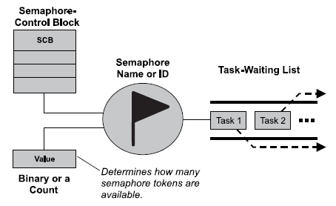
Defining Semaphore

Slide 8
A semaphore is like a key that allows a task to carry out some operation or access a resource.
If the task can acquire the semaphore, it can carry out the intended operation or access the resource.
A single semaphore can be acquired a finite number of times.
Analogy:
semaphore is like acquiring the duplicate of a key from an apartment manager—when the apartment manager runs out of duplicates, the manager can give out no more keys. Likewise, when a semaphore’s limit is reached, it can no longer be acquired until someone gives a key back or releases the semaphore.

Slide 9
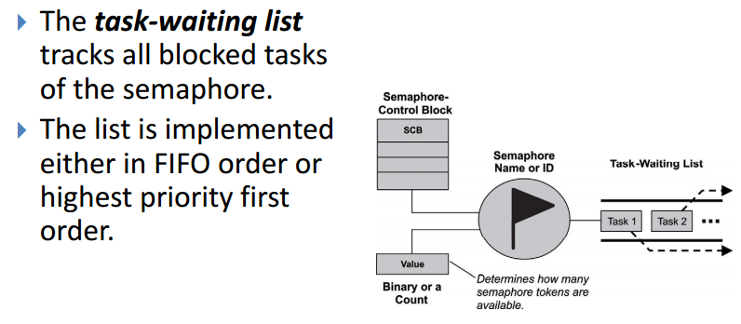

Slide 10
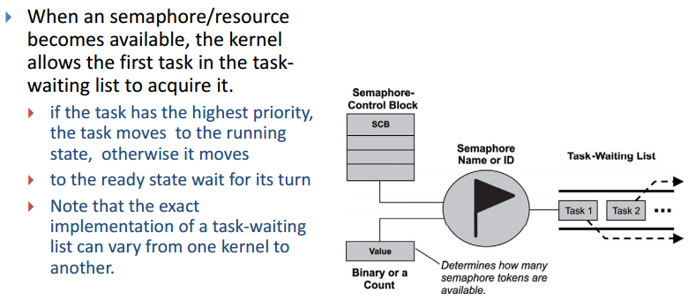

Slide 11
Types of Semaphores
A kernel can support many different types of semaphores, including
Binary Semaphore
Counting Semaphore
Mutual-exclusion (Mutex) semaphores (For resource Management)
Wait_semaphore() = acquire_semaphore()
Signal_semaphore() = release_semaphore()

Slide 12
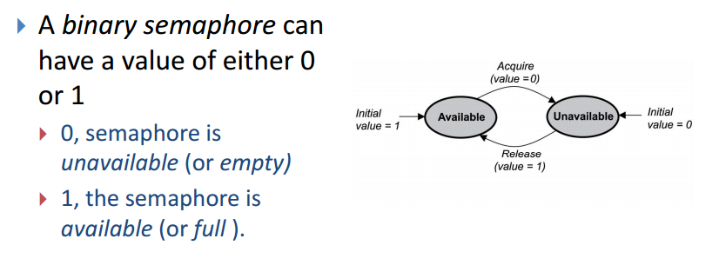
Binary Semaphore

Slide 13
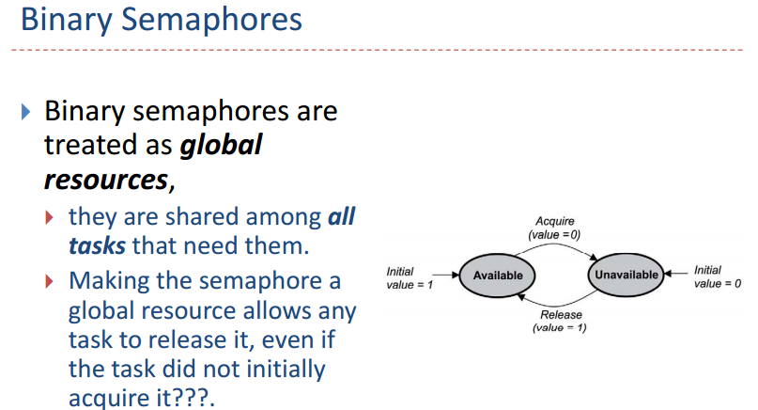

Slide 14
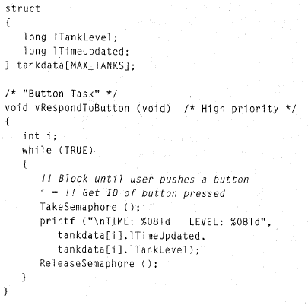
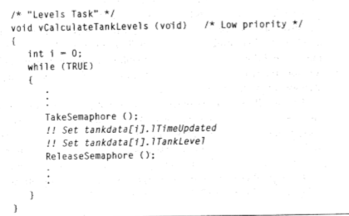
Example: Binary Semaphore

Slide 15
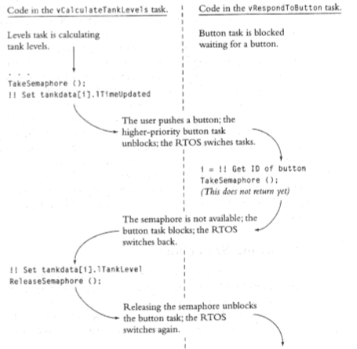
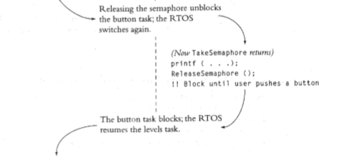

Slide 16
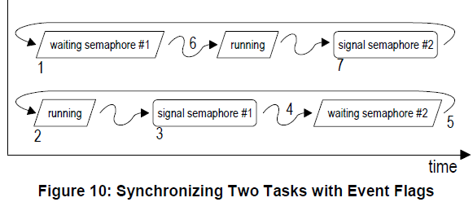
Use of semaphores in task synchronization
Following figure shows two tasks synchronizing their execution via two separate binary semaphores

Slide 17
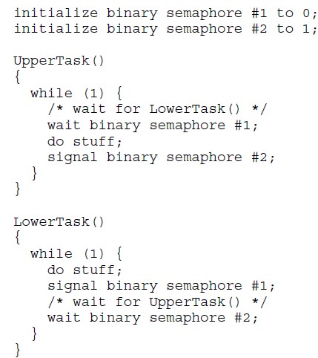


Slide 18
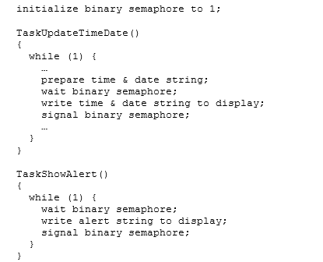
Binary semaphore for single resource management
Notes:
Mutex example I guess (Ayesha Javed)

Slide 19

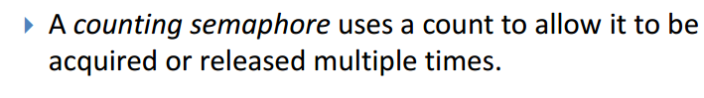
Counting Semaphore
A counting semaphore can be unsigned 8- or 16- or 32- bit integer
A value of counting semaphore controls the blocking or running of the codes of a task
The waiting task will not wait and run further if at least one token is present

Slide 20
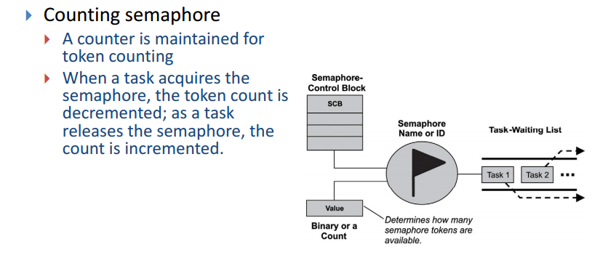

Slide 21
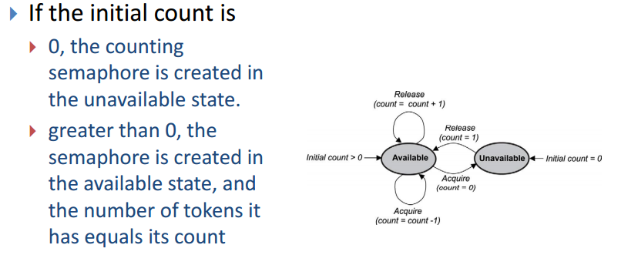

Slide 22
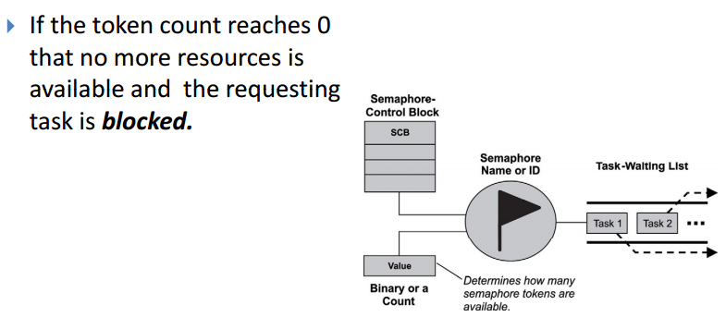

Slide 23
Managing resources using counting semaphores
Resources can also be controlled with counting semaphores.
In this case, the value of the counting semaphore represents how many of the resources are available for use.
A common example is that of a ring buffer. A ring buffer has space for m elements, and elements are added to and removed from it by different parts of an application.

Slide 24
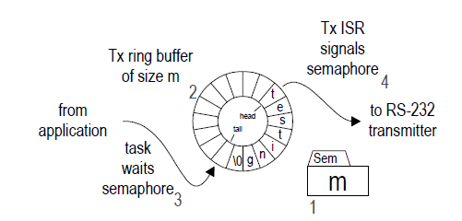
Example – Serial Communication
Following figure shows a scheme to transmit character strings via RS-232 using a counting semaphore to control access to a ring buffer.

Slide 25
a counting semaphore is initialized to m [1] to represent the number of spaces available in the empty ring buffer [2]

Slide 26
The ring buffer is filled at its tail by the task [3] and emptied from its head by the ISR [4].

Slide 27
Before adding a character to the buffer the task must wait the semaphore. If it is blocked, it means that the buffer is full and cannot accept any more characters.

Slide 28
If the buffer is not full, the semaphore is decremented, the task places the character at the tail of the buffer and increments the tail pointer.

Slide 29
Once there are characters in the buffer, for each character the Tx ISR will remove it from the buffer, transmit it and increment the semaphore by signaling it.

Slide 30
